Slide 1
ISLAMIC PATTERNS
AT THE WALLACE COLLECTION
Islamic art has a strong aesthetic appeal that transcends time and place, as well as differences in languages and culture. It is often considered sacred and made to glorify God (Allah).
Adorning buildings, manuscripts, and objects, it is traditionally made up of three visual elements: calligraphy, geometry and biomorphic patterns.
Islamic art has an underlying spirituality which gives it a coherence, regardless of the country or time in which it was created, and provides meaning and essence beyond the physical form.
As a sacred art, wherever it appears – on the interiors of buildings and designed into the architecture, illuminating manuscripts or on objects such as those in the museum’s collection – its purpose is to invoke contemplation and ultimately remind one of God. Muslims believe that there is no god but God, (the same God that Christians, Jews, and other monotheistic faiths believe in).
There is a tradition of the Prophet Muhammad, where he says ‘No one will enter Paradise who has an atom’s weight of pride in his heart.’ A man responds, ‘What if a man likes his clothes to look good and his shoes to look good?’. The Prophet said, ‘Allah is beautiful and loves beauty. Pride means denying the truth and looking down on people.’
The Qur’an encourages people to do everything we can with ihsan – with excellence, and with taqwa – god-consciousness. This includes art, design, architecture, and all aspects of creativity.

Slide 2
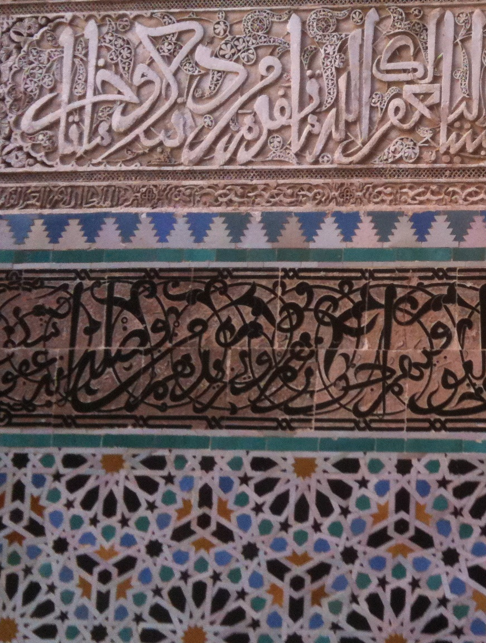
ISLAMIC PATTERNS
^{THREE KEY ELEMENTS}
AT THE WALLACE COLLECTION
^{Calligraphy}
Verses of the Qur’an, sayings of the Prophet Muhammad, and poetry, often in beautifully written Arabic and Farsi script using ink and reed pens, to beautify the word of God and bring it to life on the page, forming a relationship with the onlooker even if they do not know the language.
^{Geometry}
Shape-based patterns that are derived from a single circle, and repeated over an underlying grid construction. The number patterns found in Islamic geometric patterns are often the same number patterns that are found in the natural world, the cosmos, even our own molecular structure. The patterns serve as a reminder to contemplate the vastness of creation, the creator God, and humanity’s role within the universe.
^{Islimi (biomorphic)}
These are floral, leaf and spiral patterns that are inspired by flowers and leaves in nature, but are stylised versions of them. In some areas they are more naturalistic than others. They surround calligraphic inscriptions and are painted on tiles to remind the onlooker that there is a life after death, and of gardens of paradise, for which we have no image so can only imagine.
^{PLACE}
^{DATE}
Al-Qarawiyyin University Fez, Morocco
^{859 AD}

Slide 3
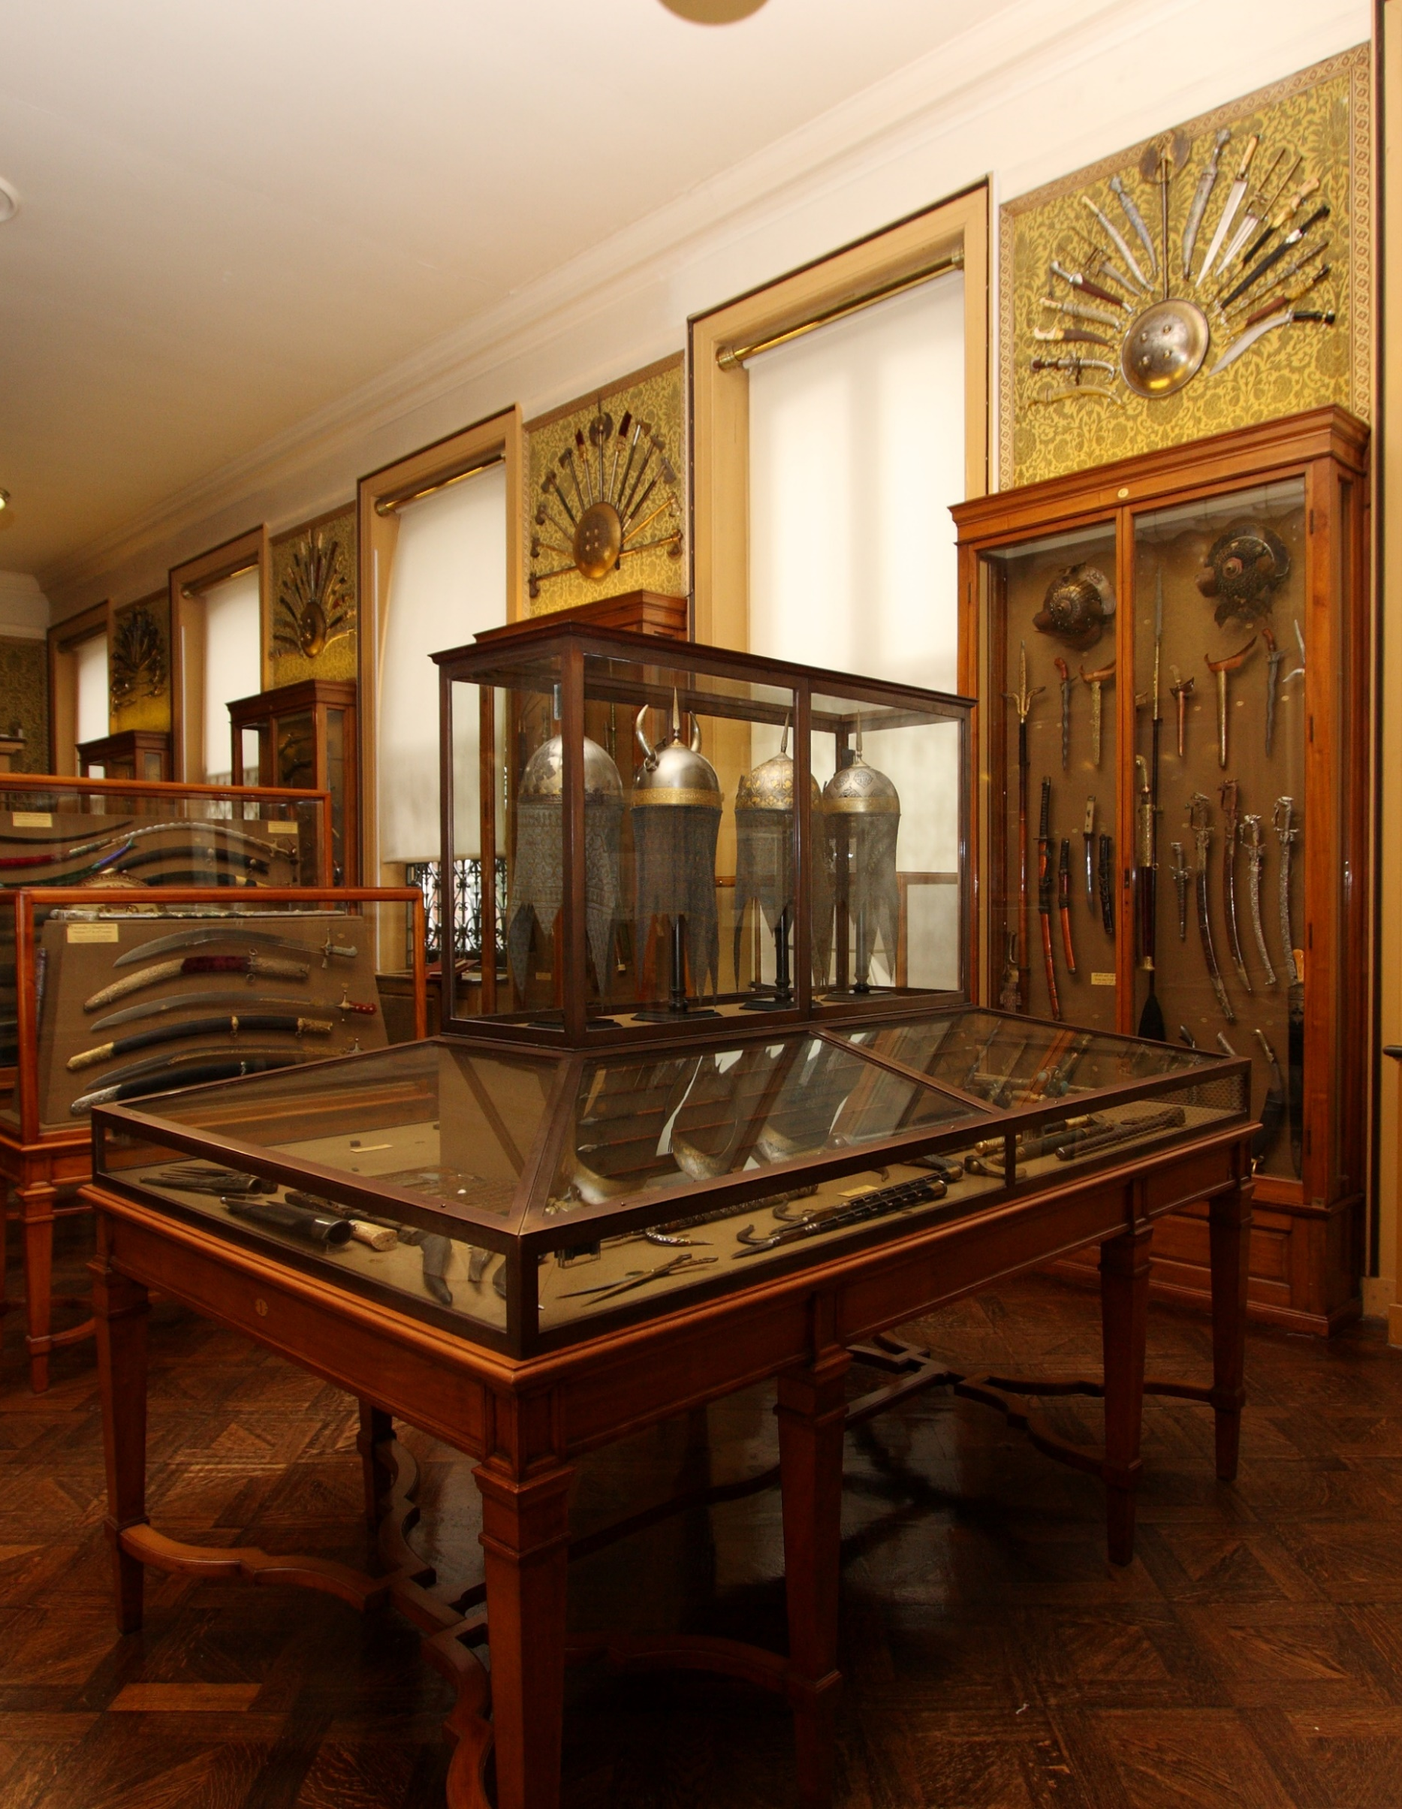
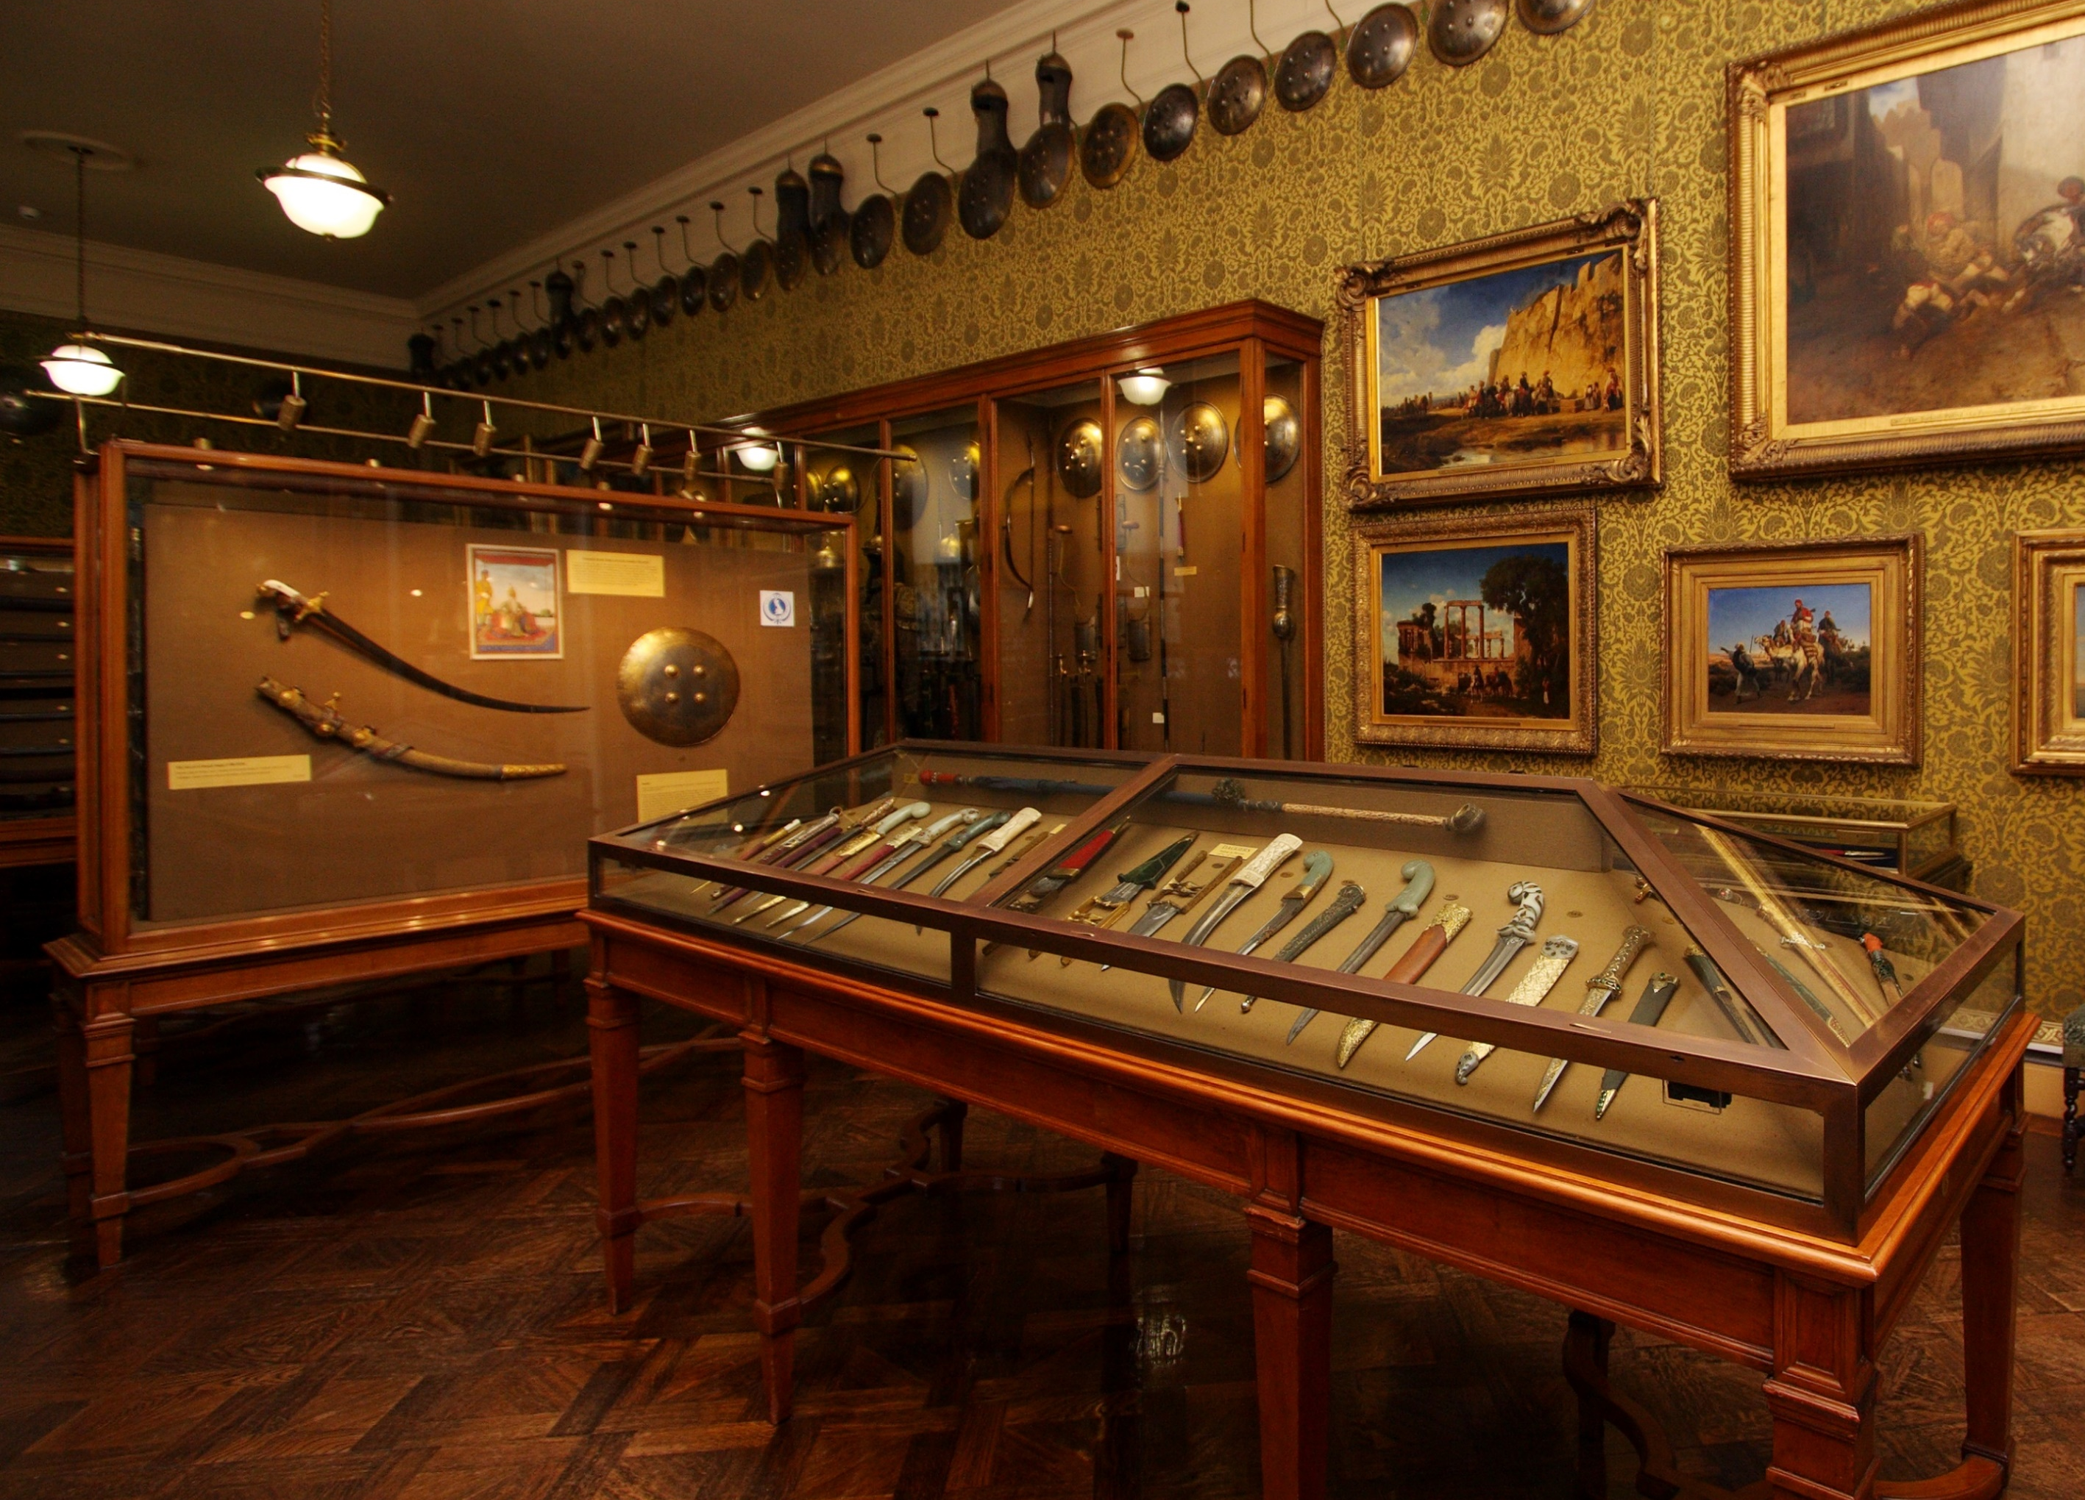
ISLAMIC PATTERNS
THE ARMOURIES AT THE WALLACE COLLECTION
AT THE WALLACE COLLECTION

Slide 4
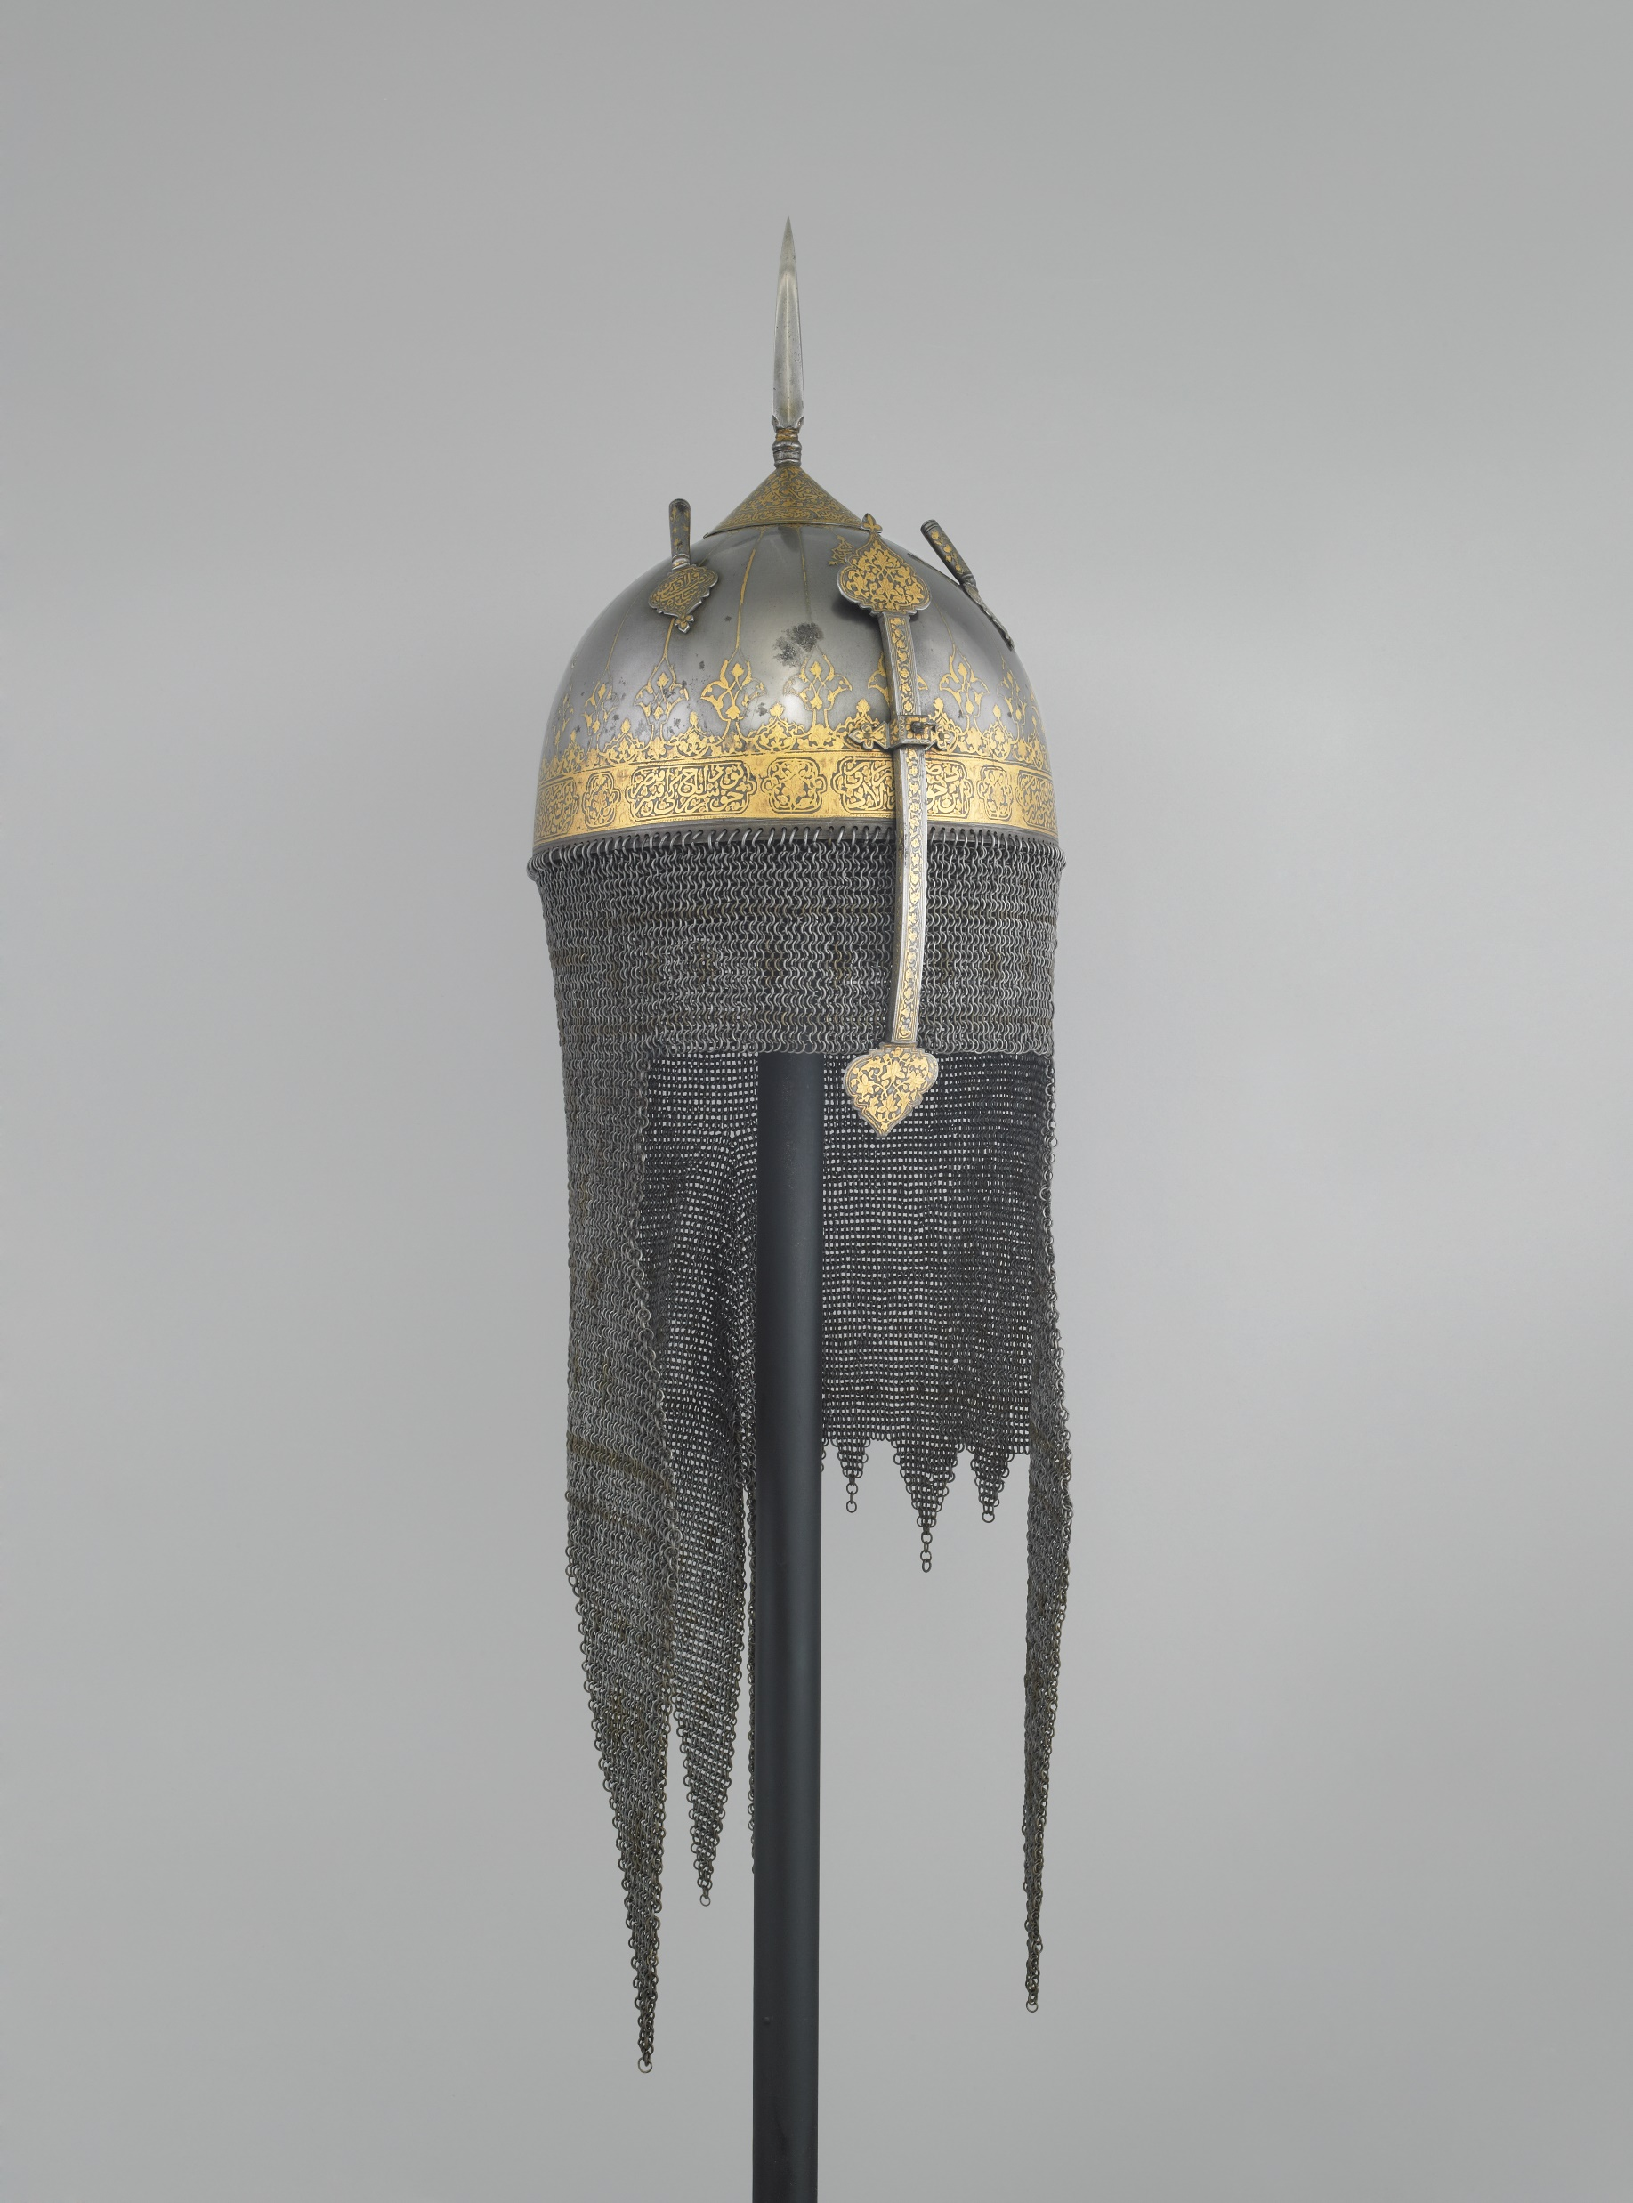
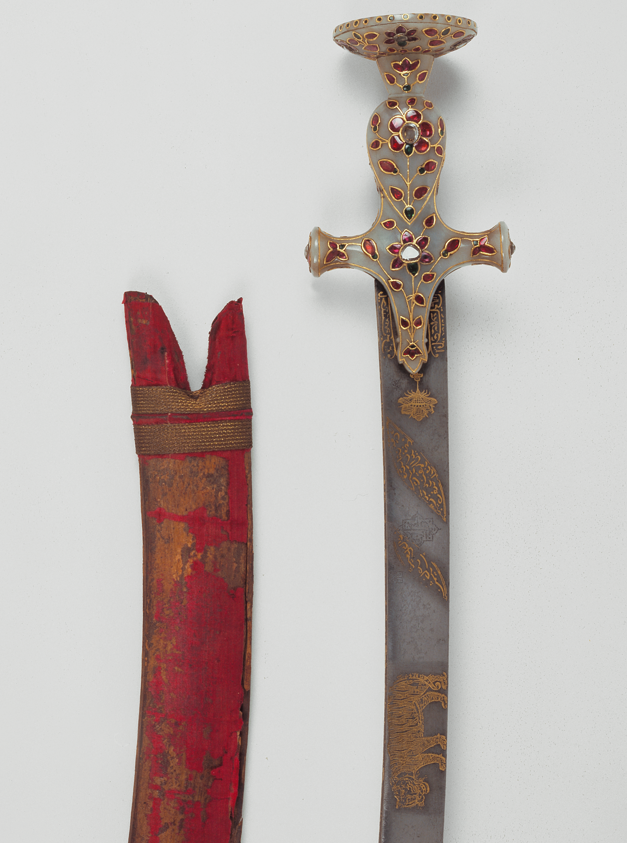
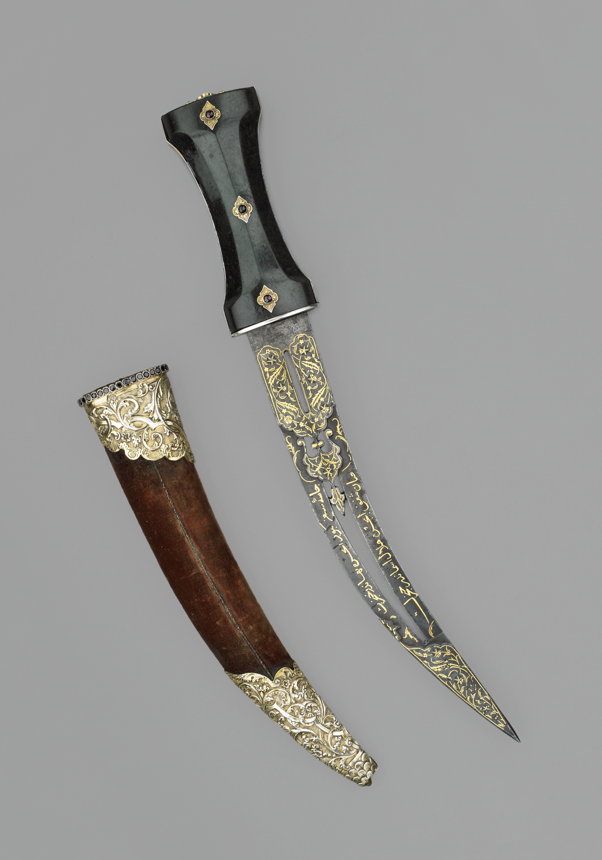
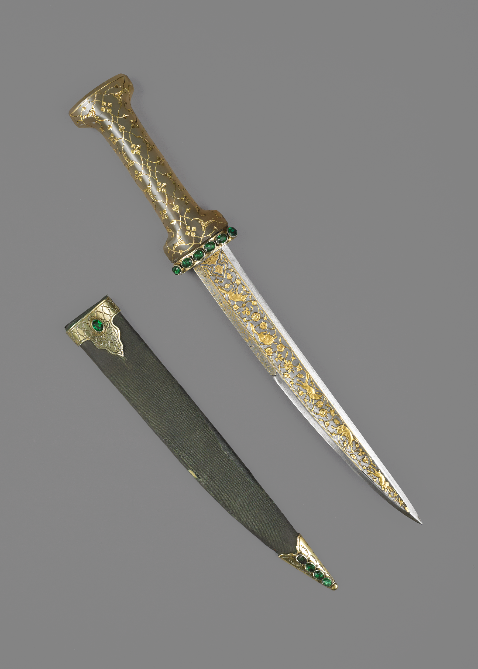
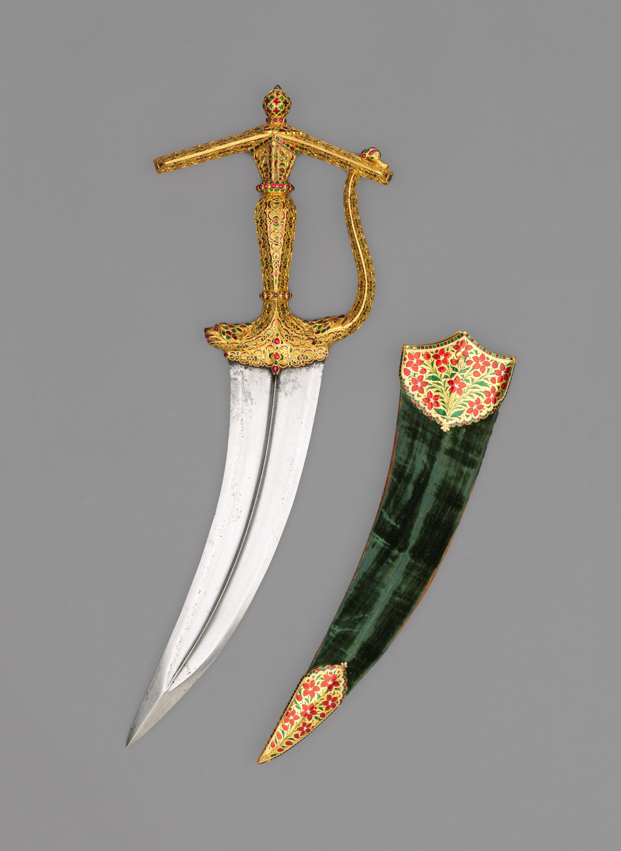
ISLAMIC PATTERNS
AT THE WALLACE COLLECTION
KEY WORKS

Slide 5
ISLAMIC PATTERNS
^{SWORD}
AT THE WALLACE COLLECTION
^{DATE}
^{MATERIALS}
^{SIZE}
^{PLACE}
^{MAKER}
^{18th century}
Gold, steel, jade, rubies, diamonds
^{88.5 cm length}
^{India}
^{Asadullah Isfahani}

Slide 6
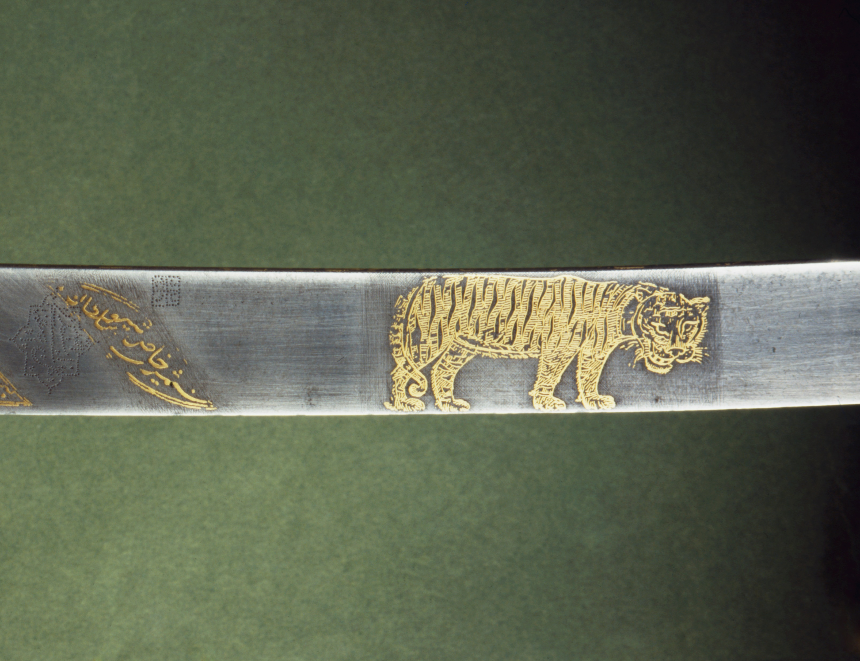
ISLAMIC PATTERNS
^{SWORD}
AT THE WALLACE COLLECTION

Slide 7
ISLAMIC PATTERNS
^{DAGGER - 17TH CENTURY}
AT THE WALLACE COLLECTION
^{DATE}
^{MATERIALS}
^{SIZE}
^{PLACE}
^{MAKER}
^{Early 17th century}
Gold, rubies, emeralds, diamonds
^{35.1 cm}
^{India}
^{Unknown}

Slide 8
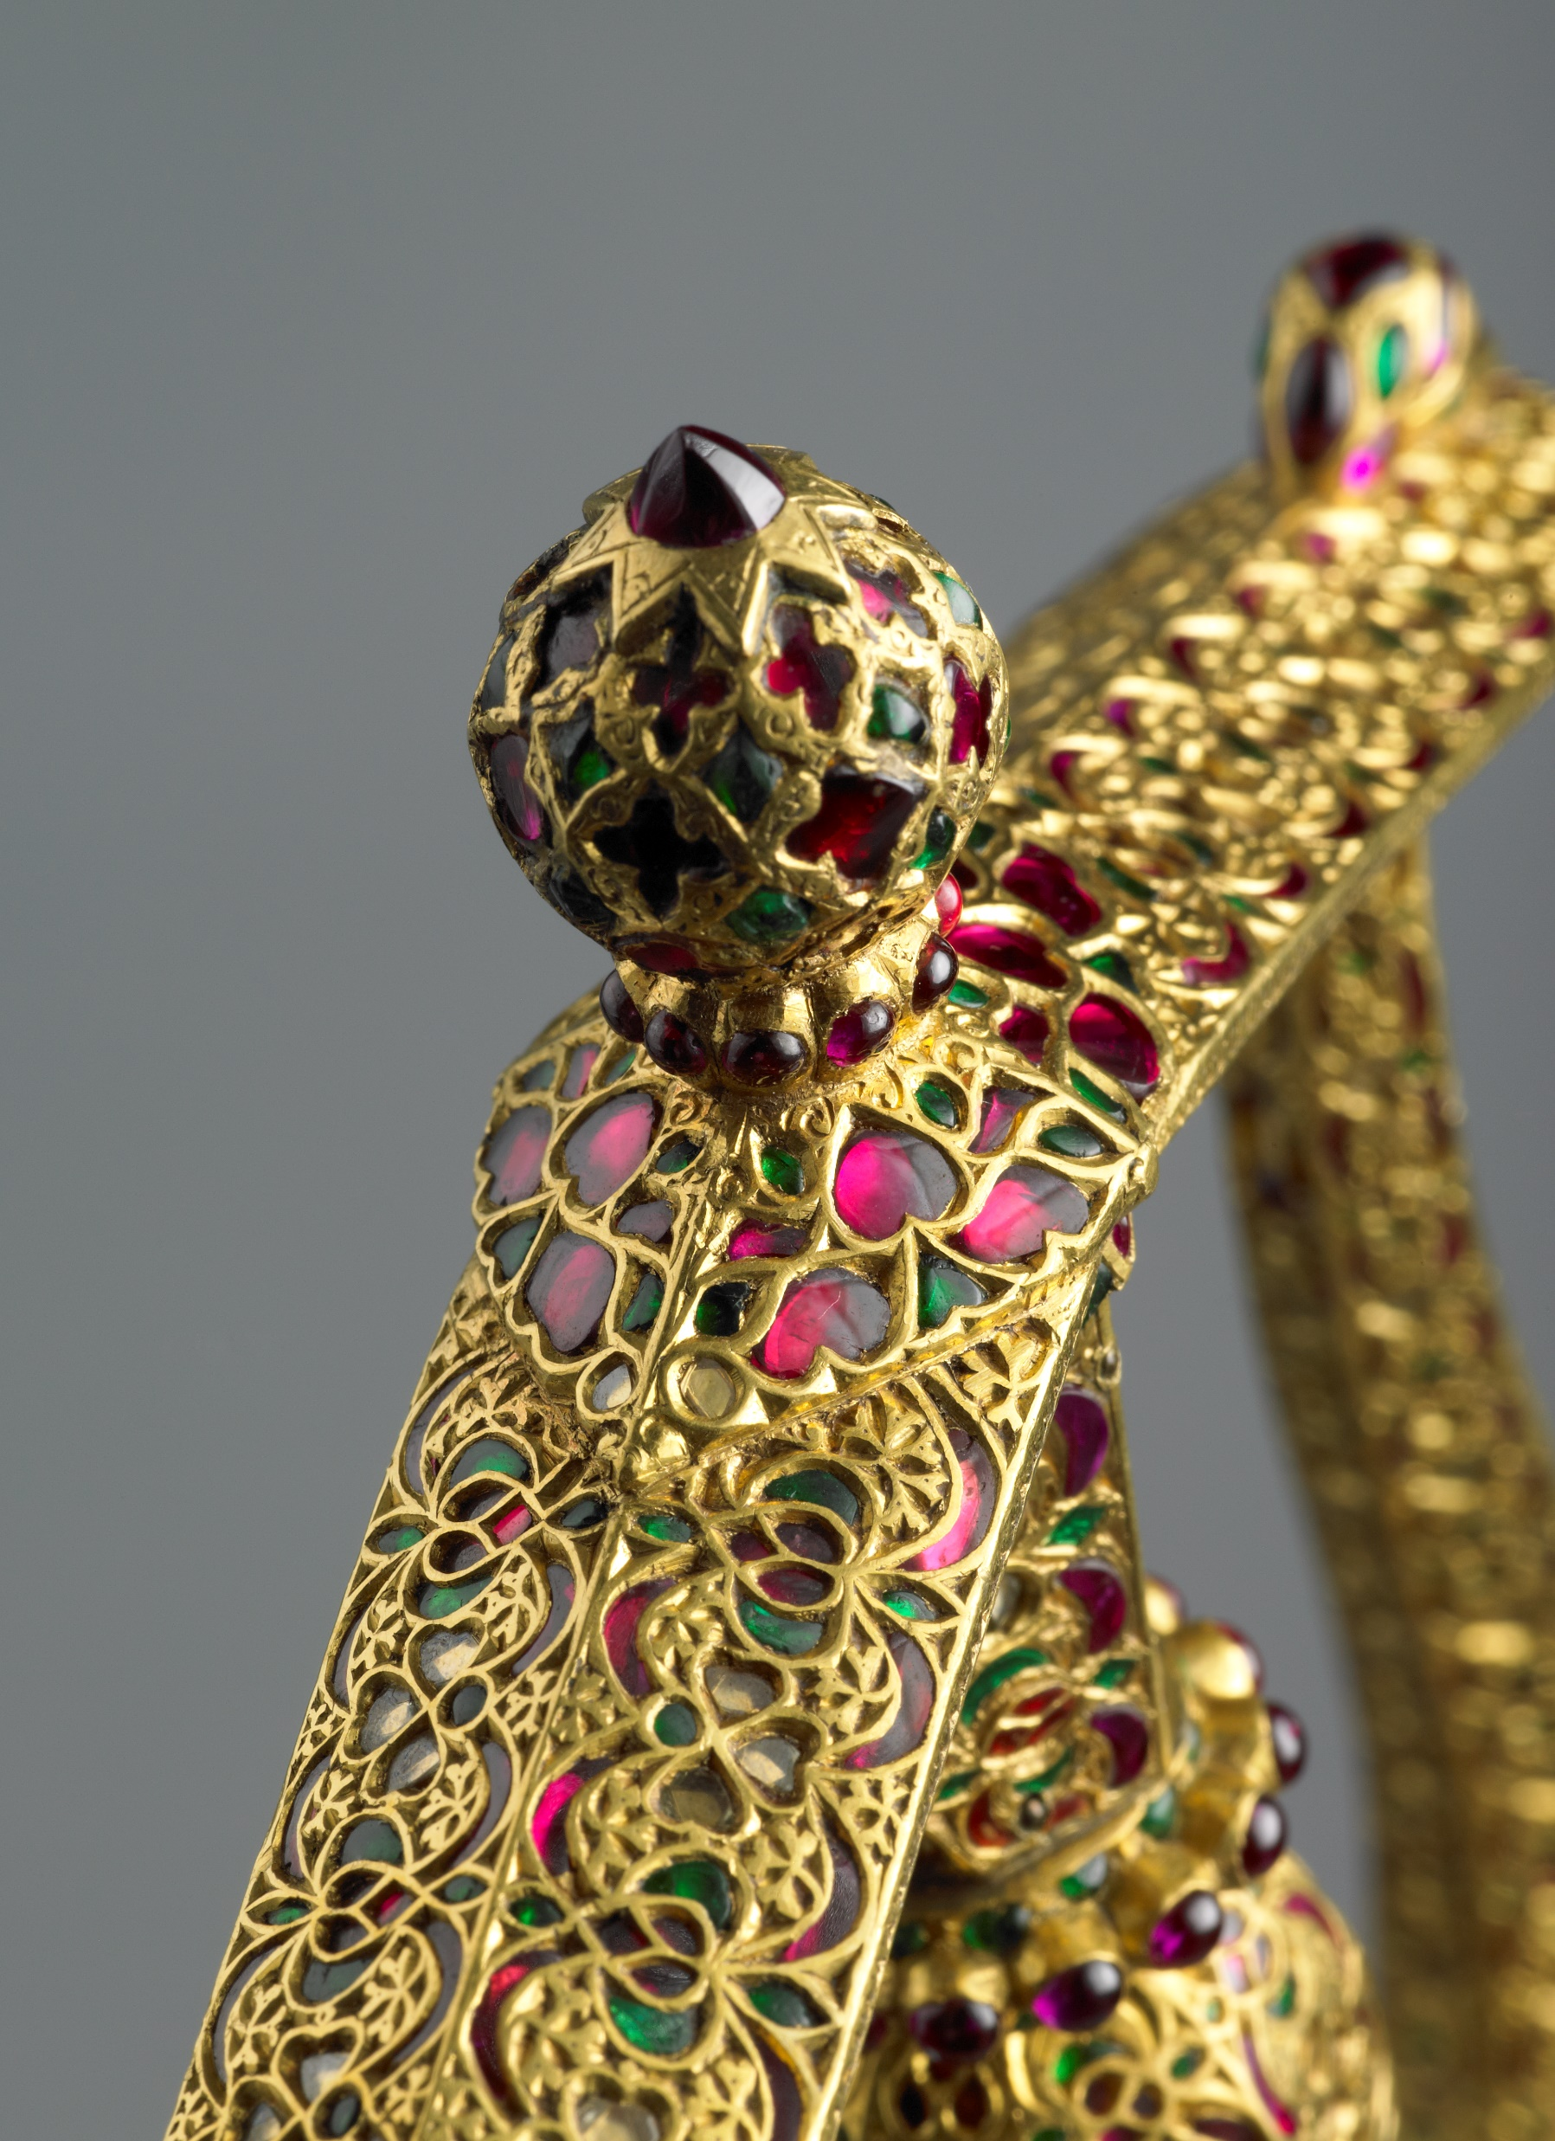
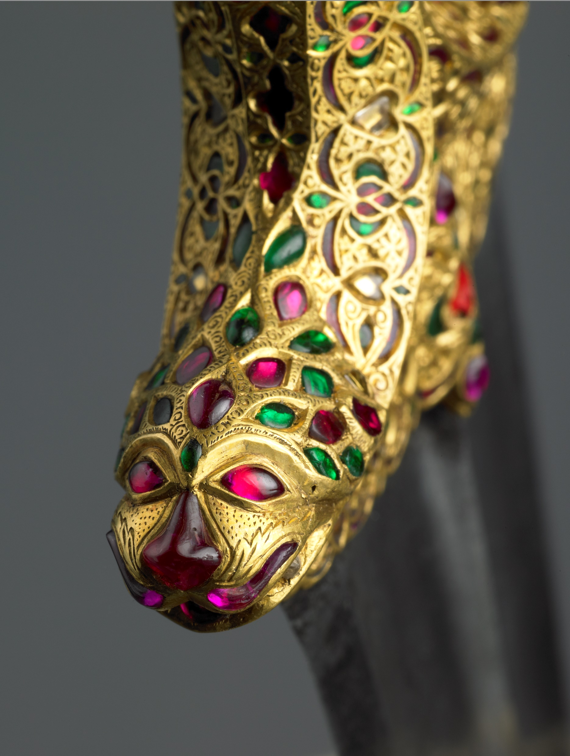
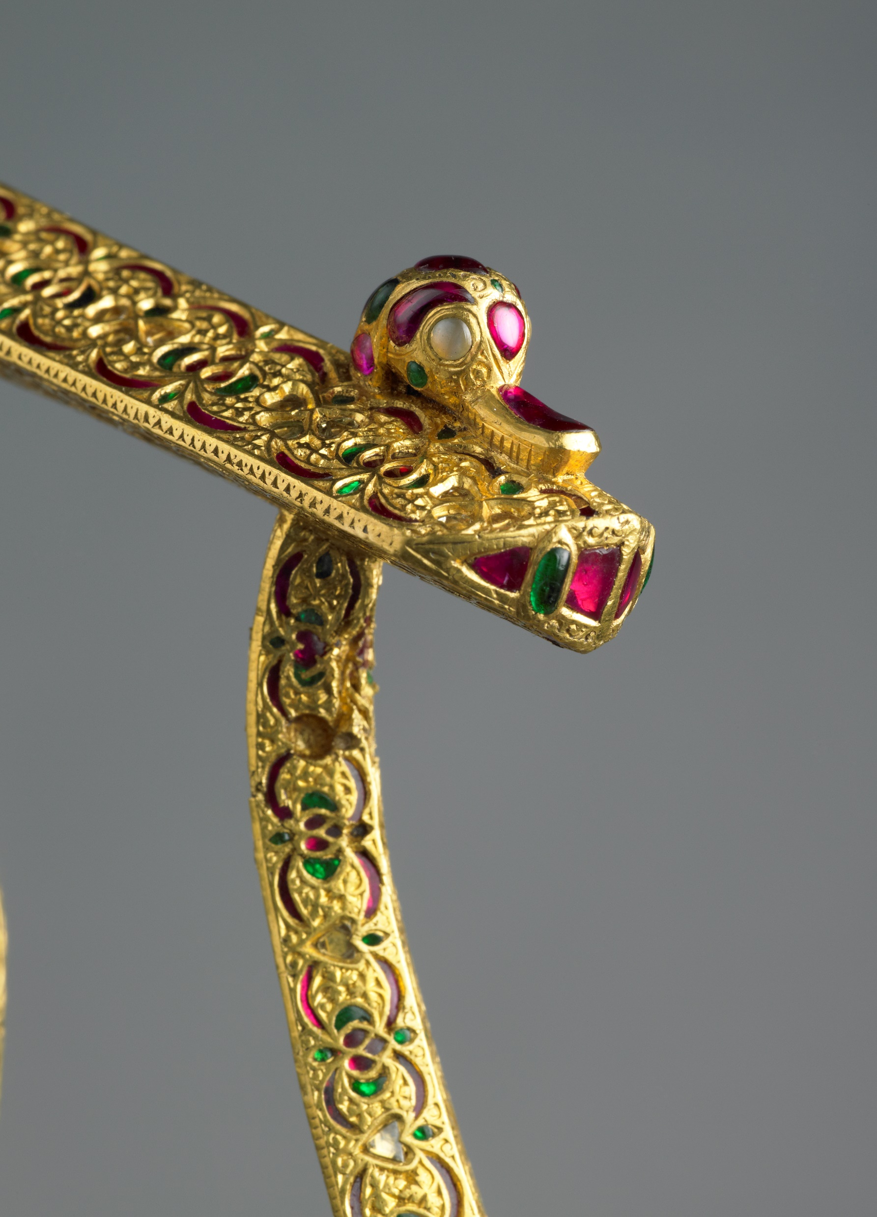
ISLAMIC PATTERNS
^{DAGGER - 17TH CENTURY}
AT THE WALLACE COLLECTION

Slide 9
ISLAMIC PATTERNS
^{DAGGER - 16TH CENTURY}
AT THE WALLACE COLLECTION
^{DATE}
^{MATERIALS}
^{SIZE}
^{PLACE}
^{MAKER}
^{16th Century}
Steel, gold, turquoise, garnets
^{22.2cm blade length}
^{Iran and Ottoman Empire}
^{Unknown}

Slide 10
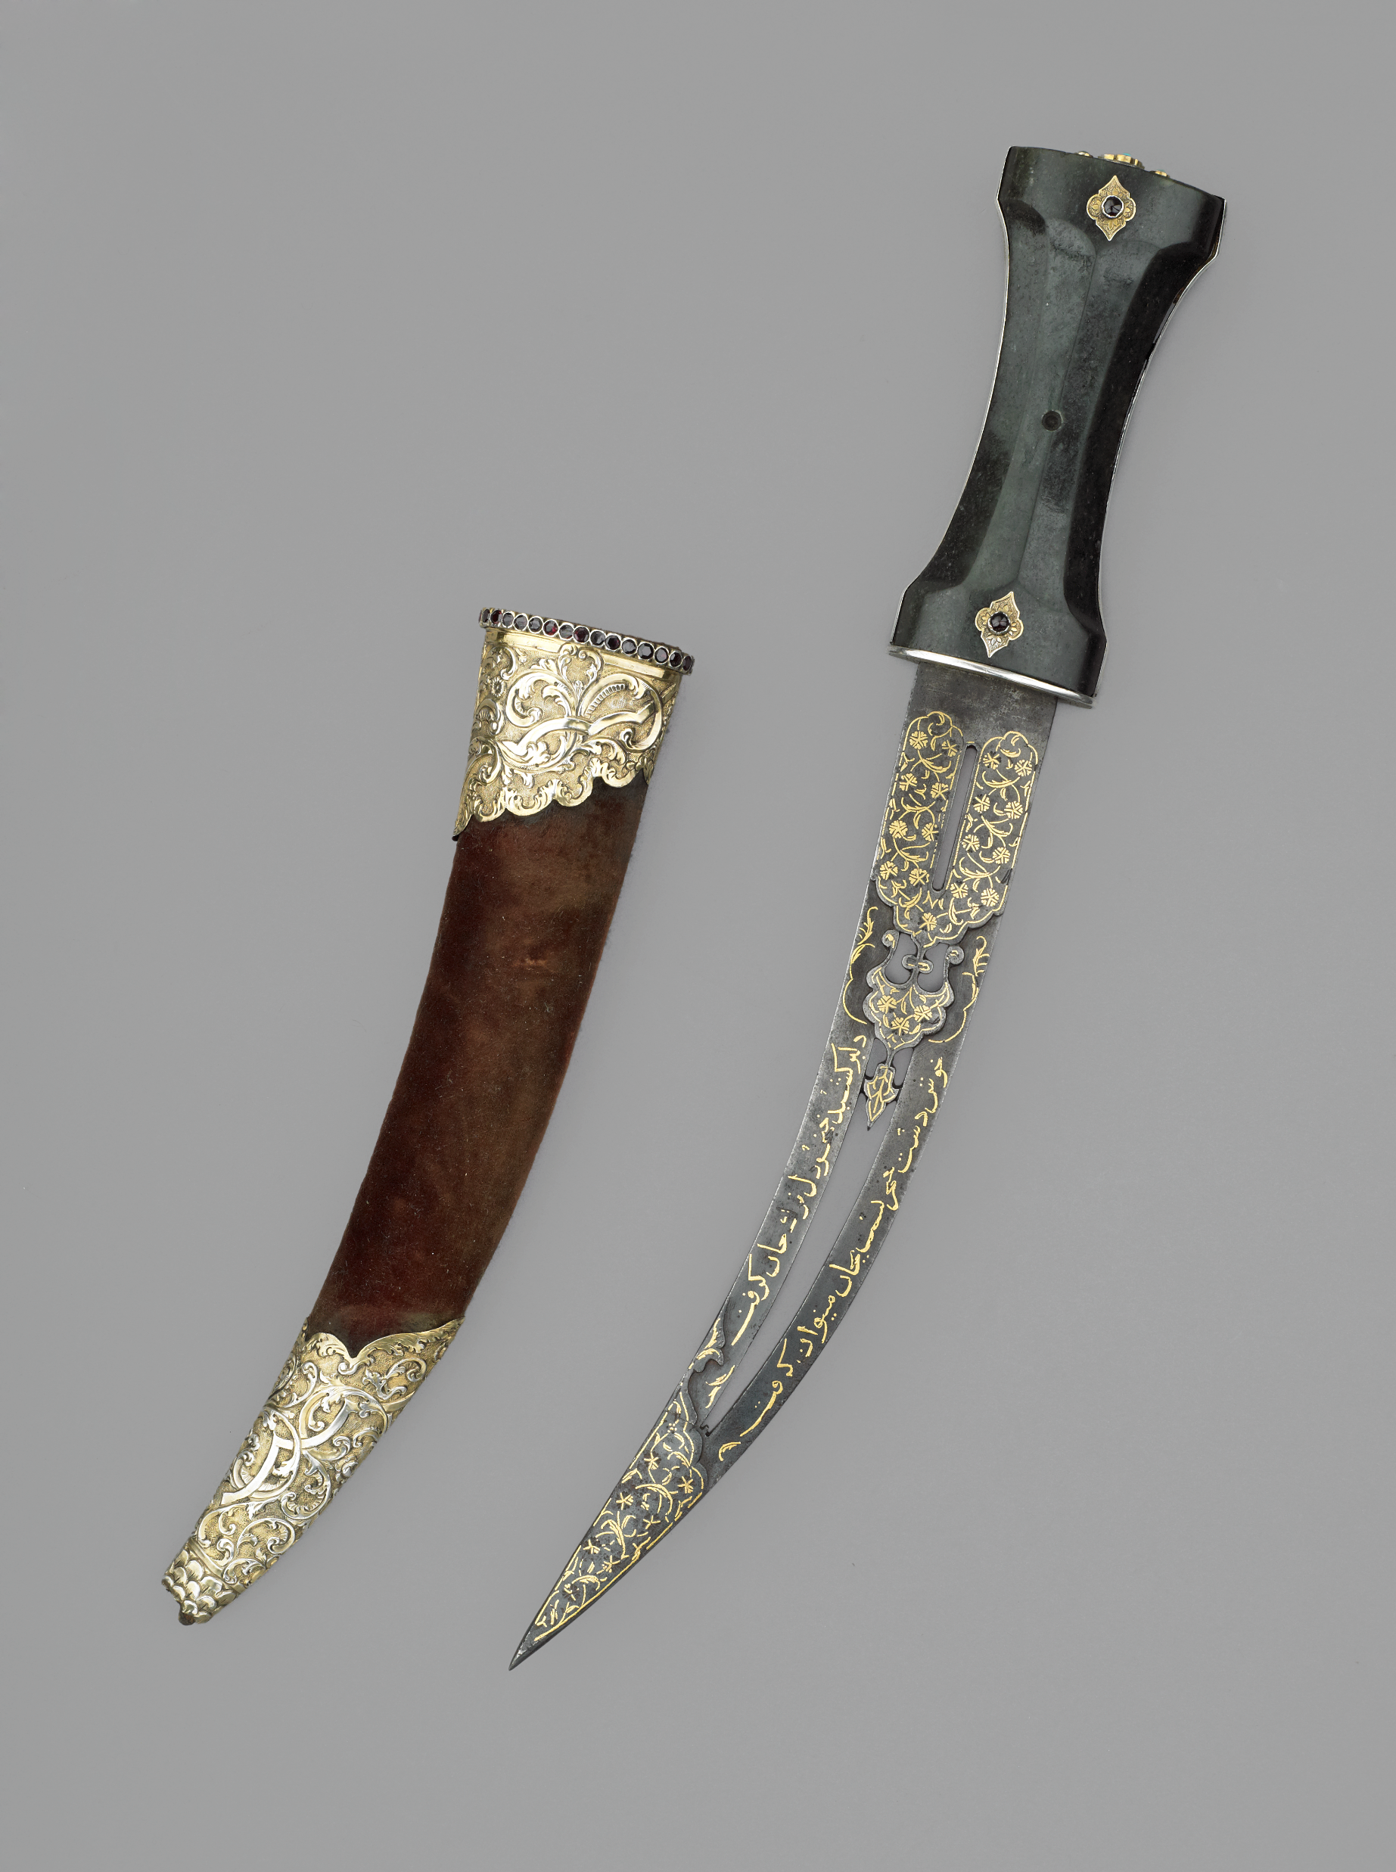
ISLAMIC PATTERNS
^{DAGGER - 16TH CENTURY}
AT THE WALLACE COLLECTION

Slide 11
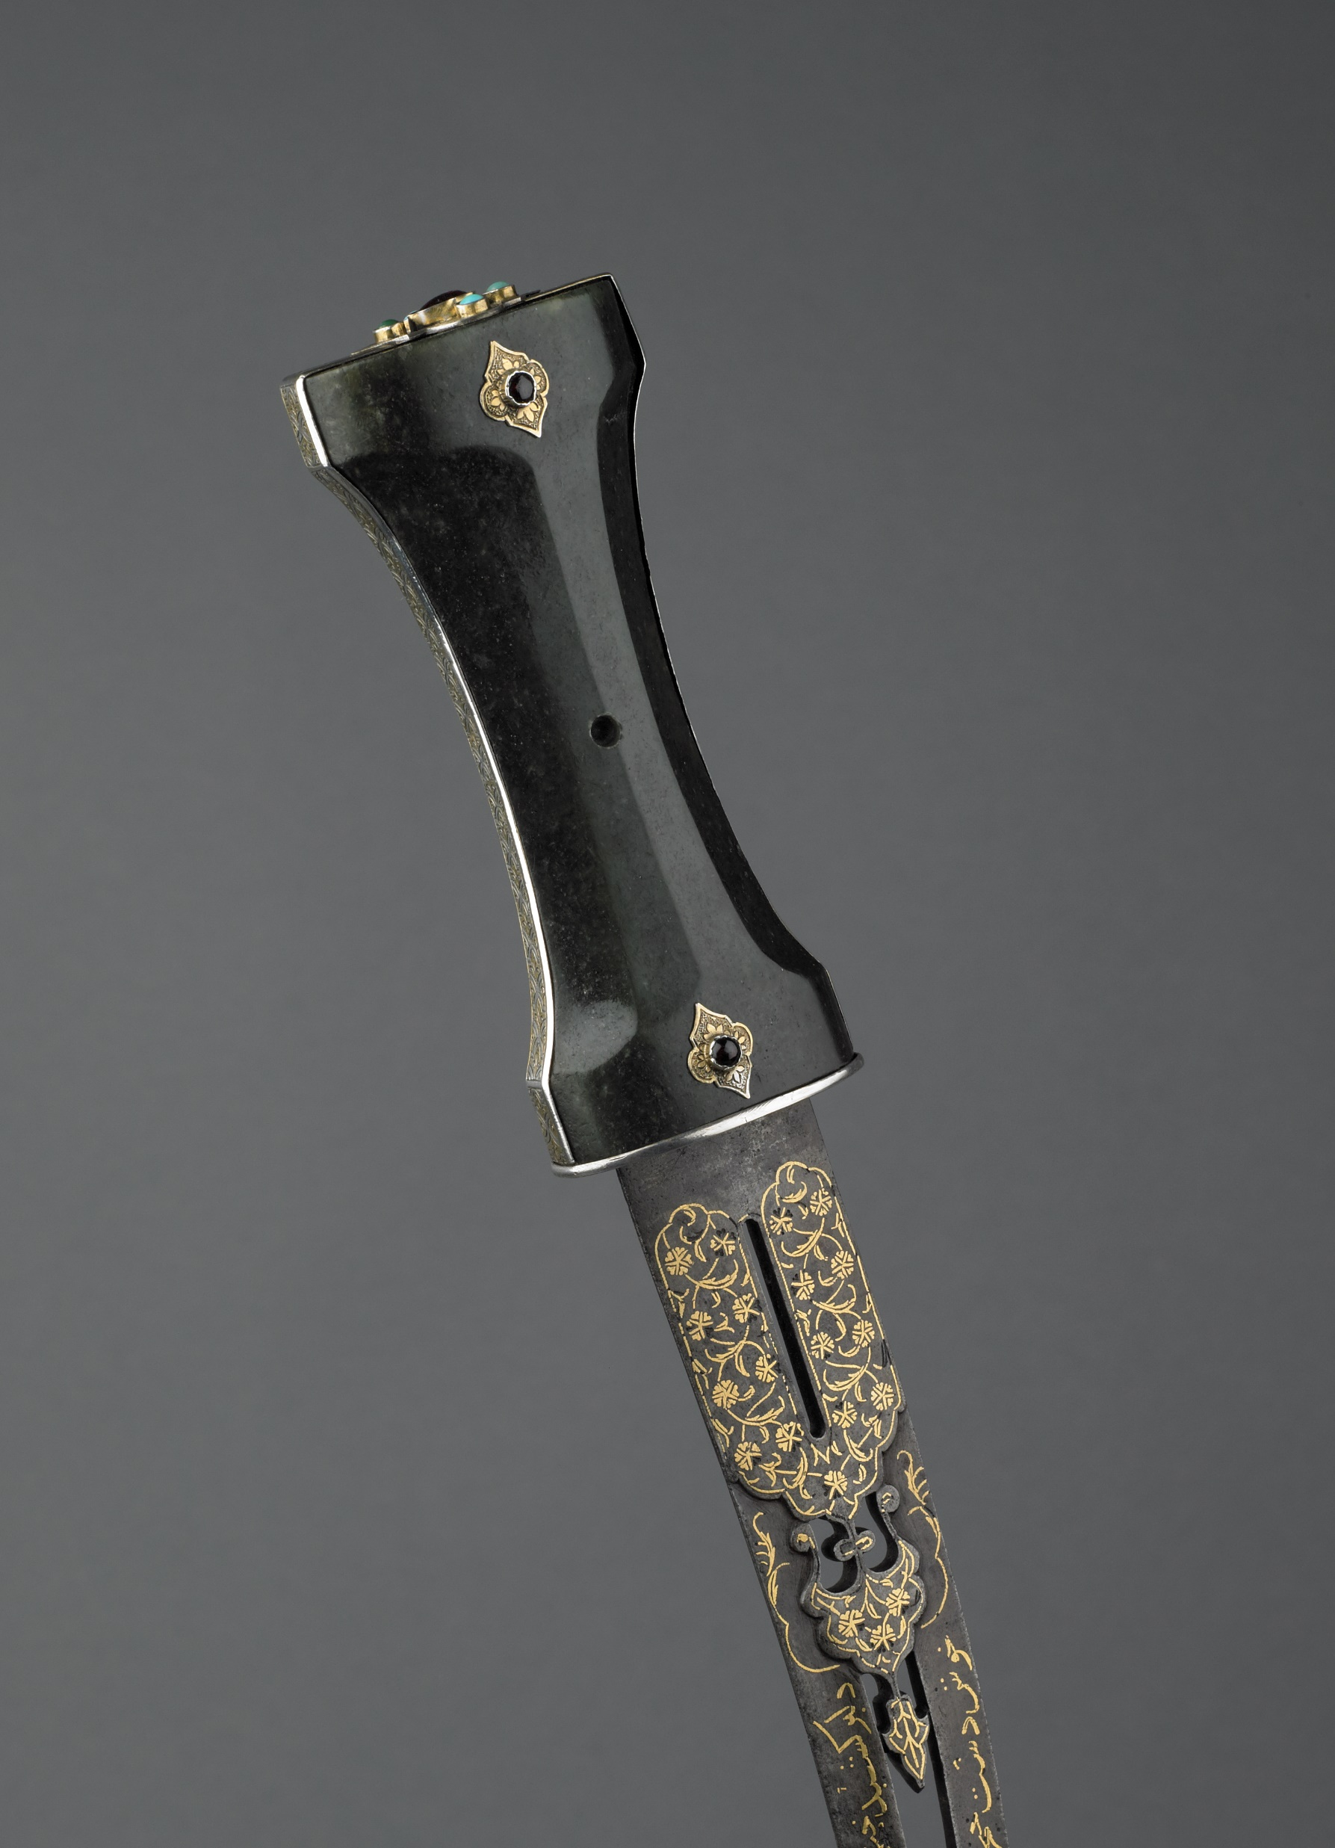
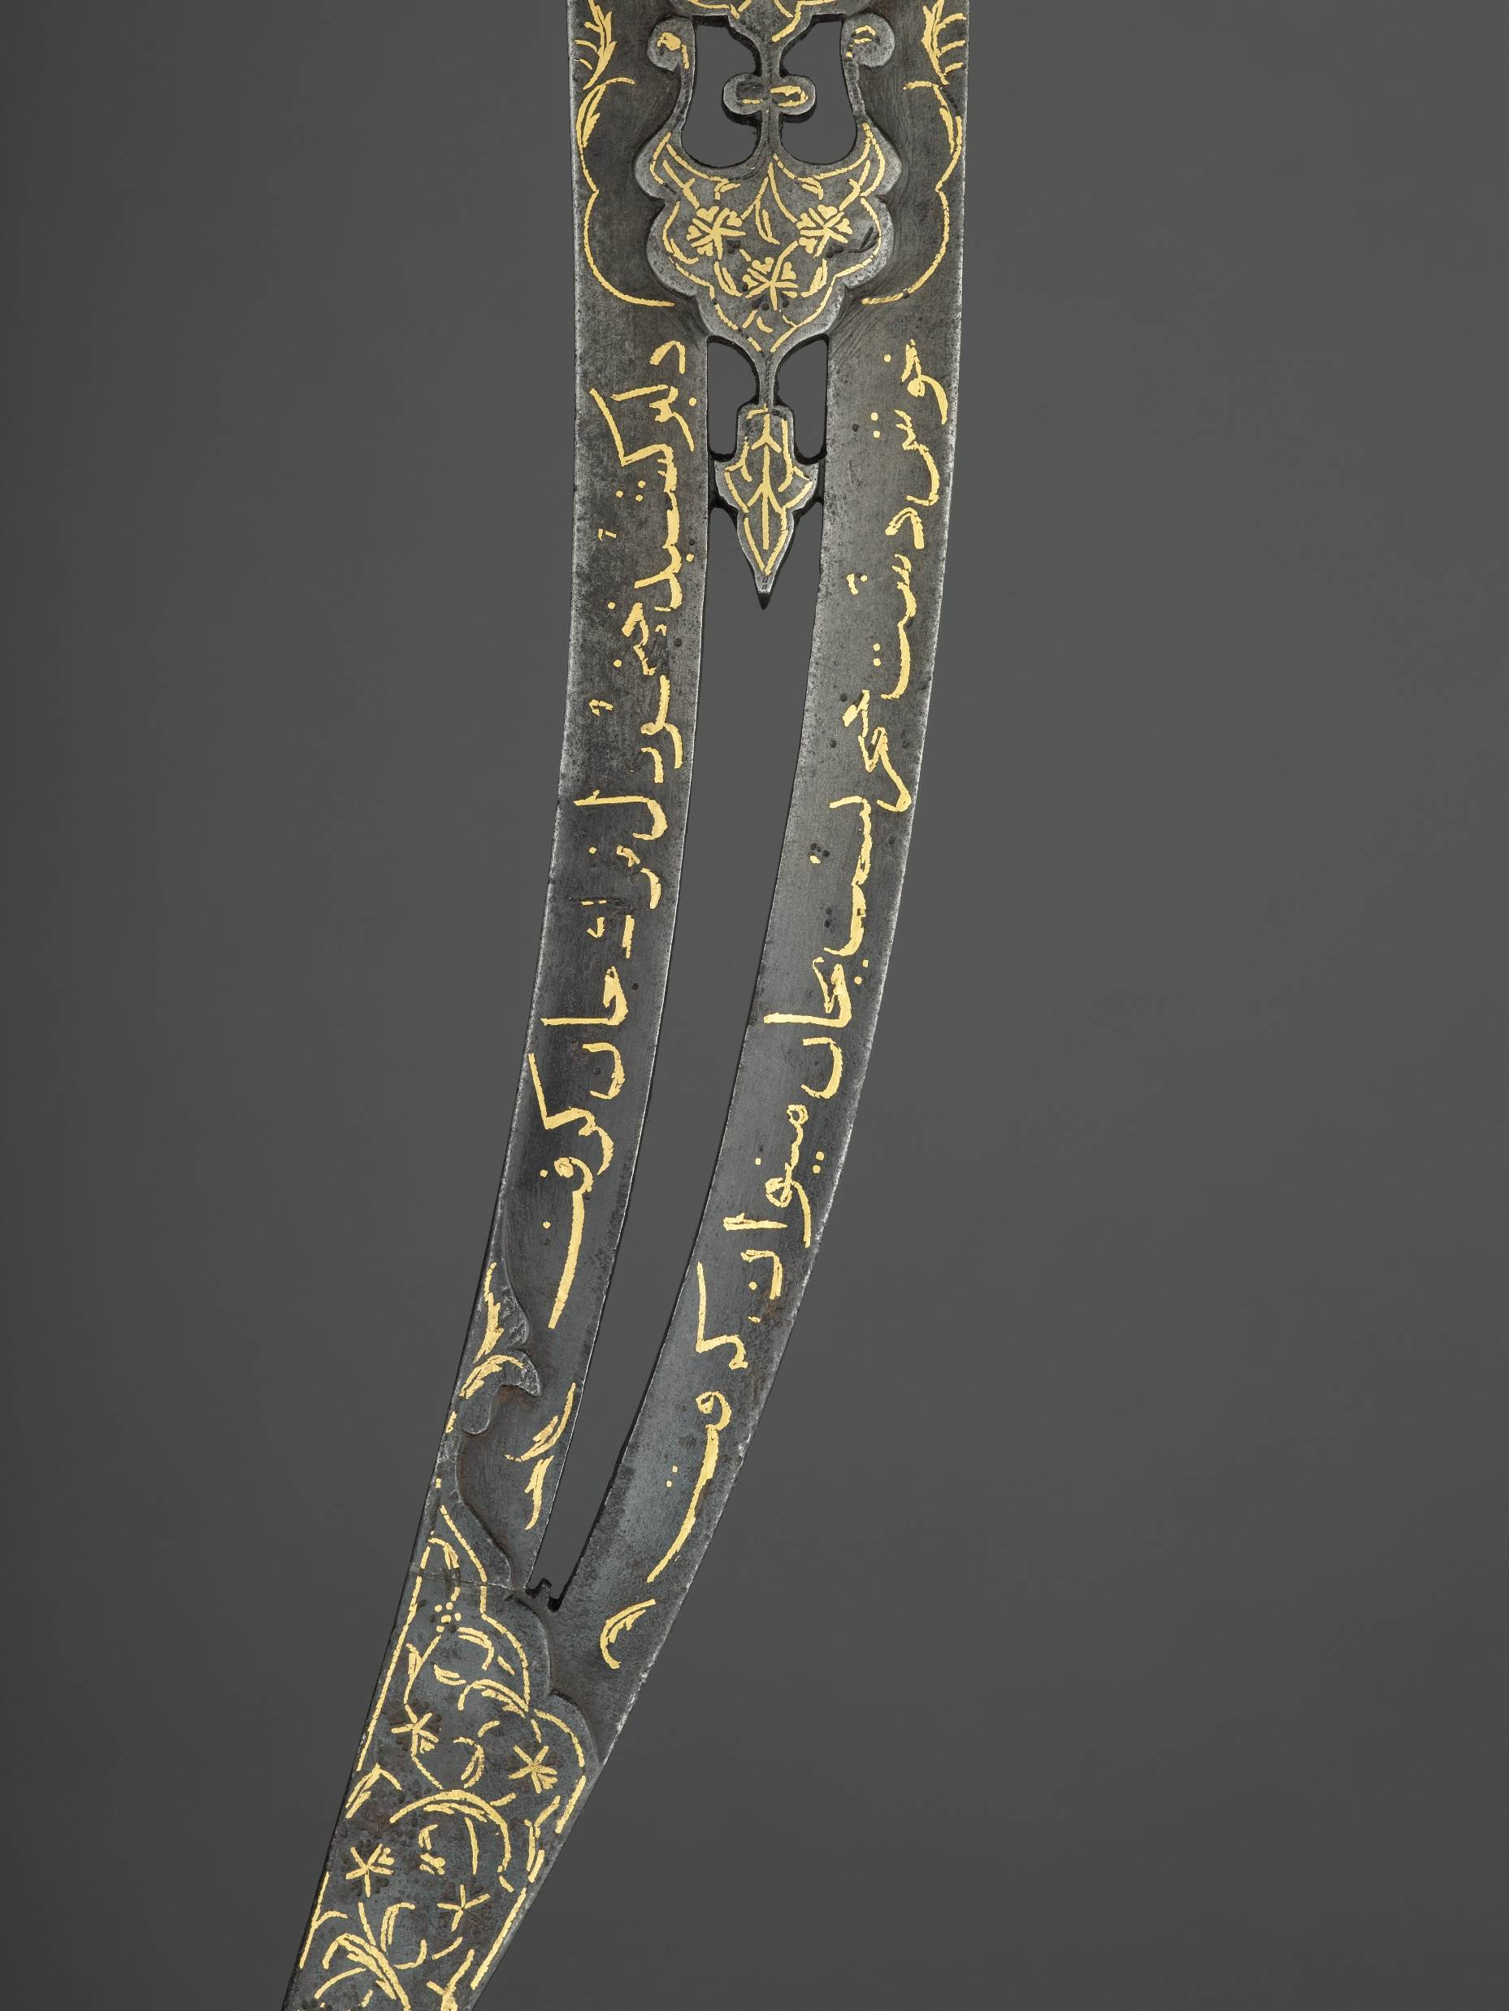
ISLAMIC PATTERNS
^{DAGGER - 16TH CENTURY}
AT THE WALLACE COLLECTION

Slide 12
ISLAMIC PATTERNS
^{DAGGER - 15TH CENTURY}
AT THE WALLACE COLLECTION
^{DATE}
^{MATERIALS}
^{SIZE}
^{PLACE}
^{MAKER}
^{Late 15th Century}
Steel, gold, chalcedony, paste, bitumen
^{8.5 cm blade length}
^{Iran or Central Asia}
^{Unknown}

Slide 13
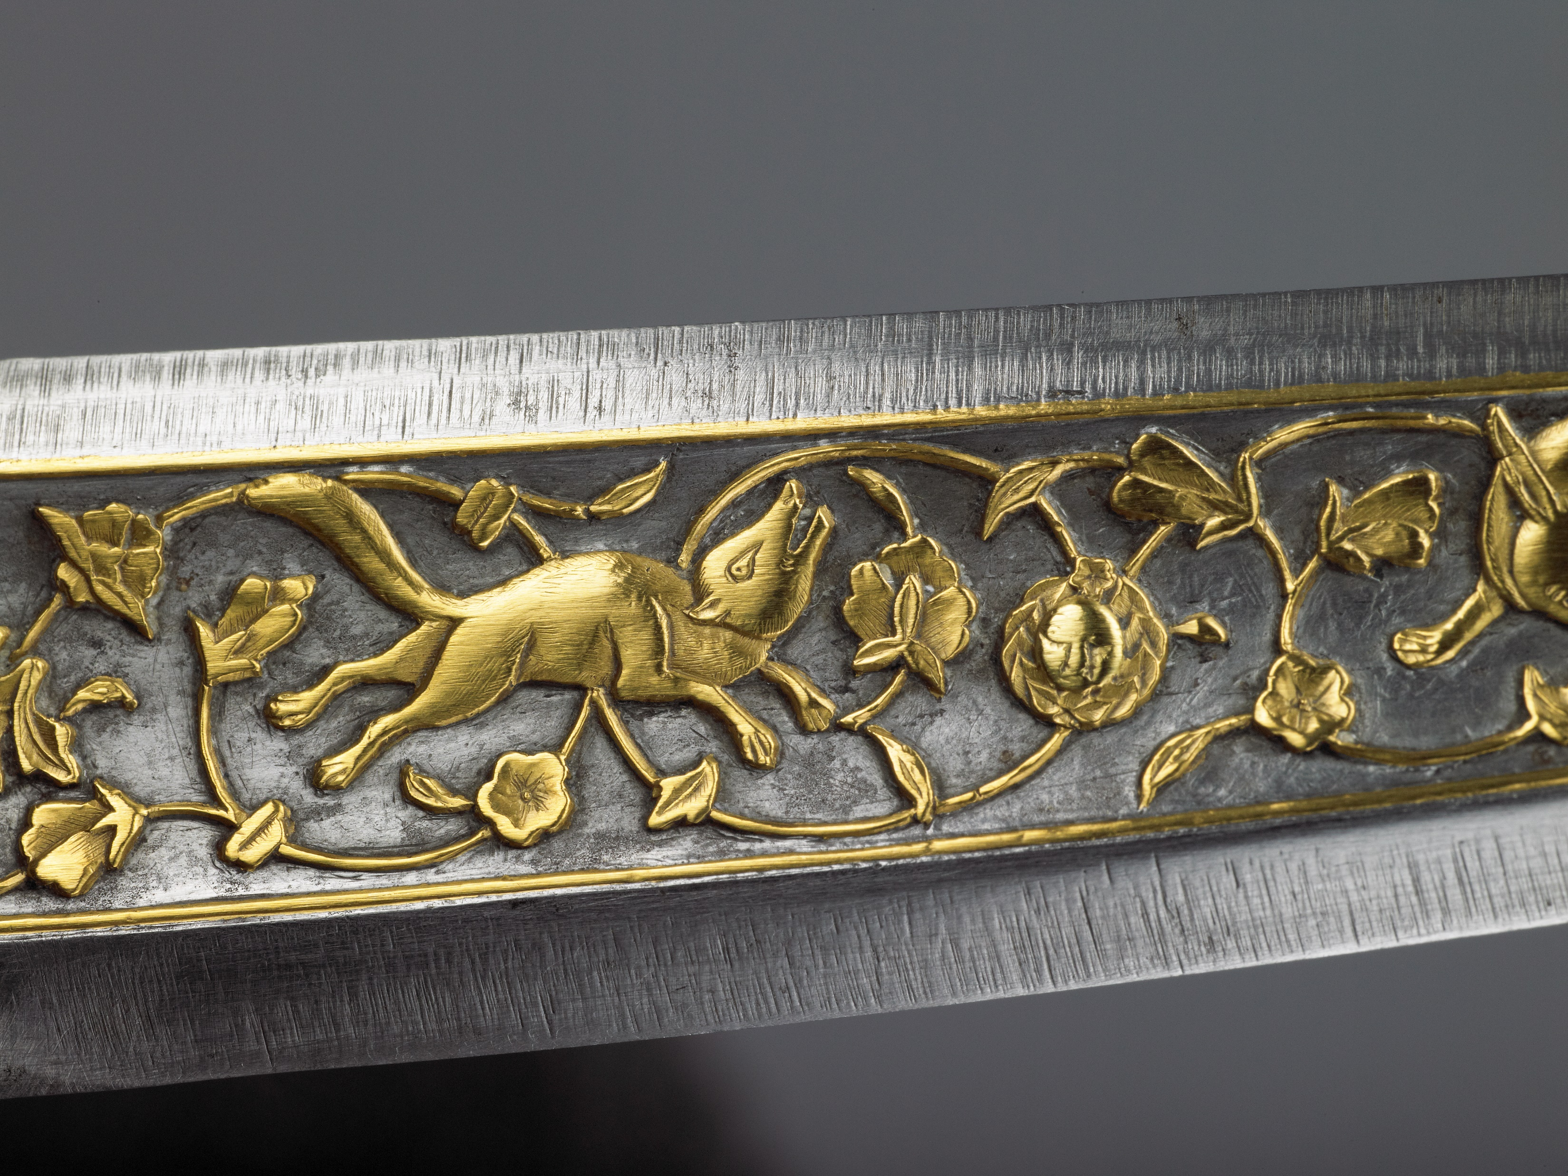
ISLAMIC PATTERNS
^{DAGGER - 15TH CENTURY}
AT THE WALLACE COLLECTION

Slide 14
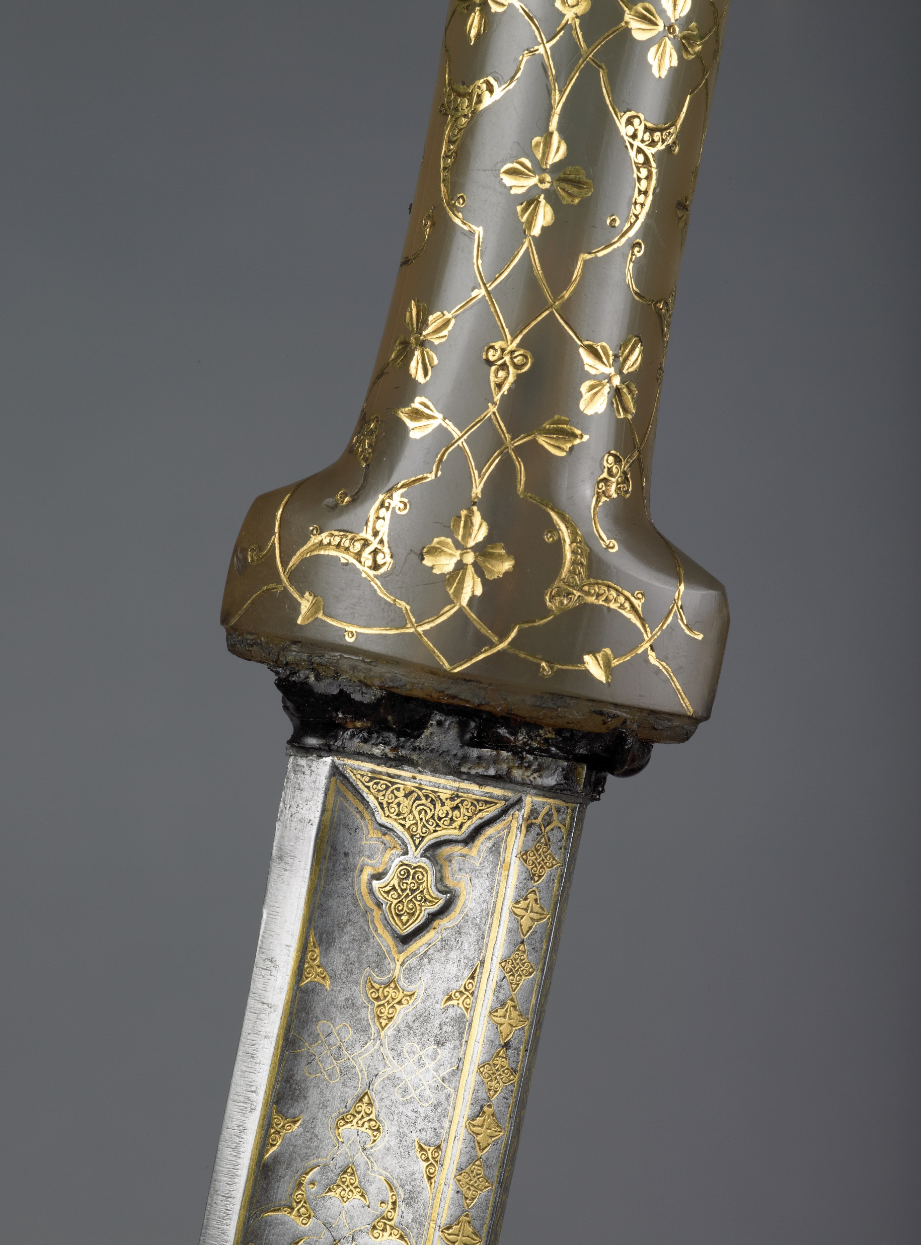
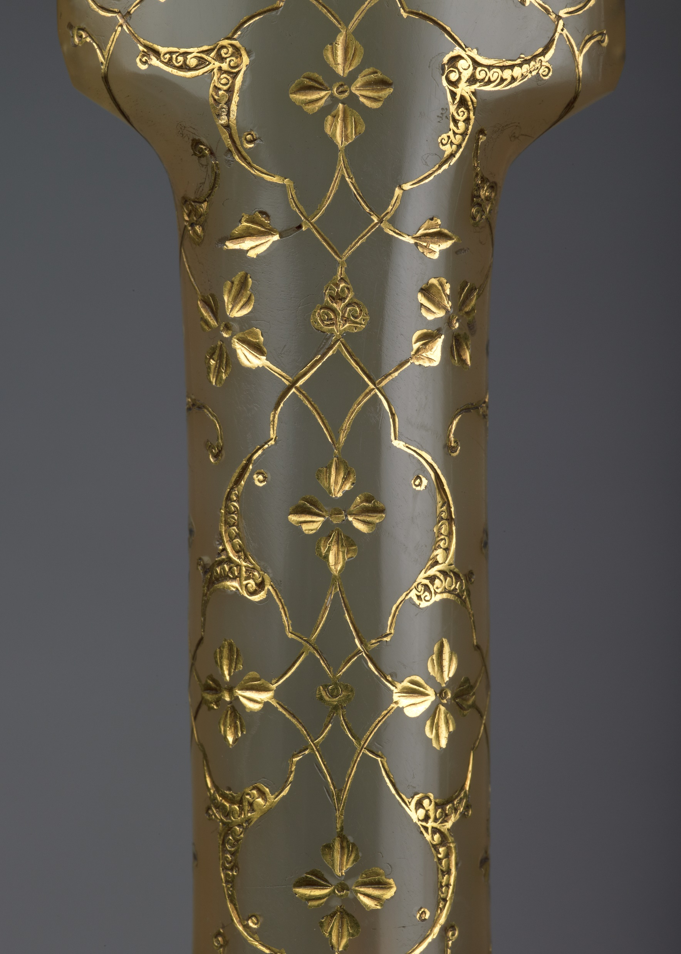
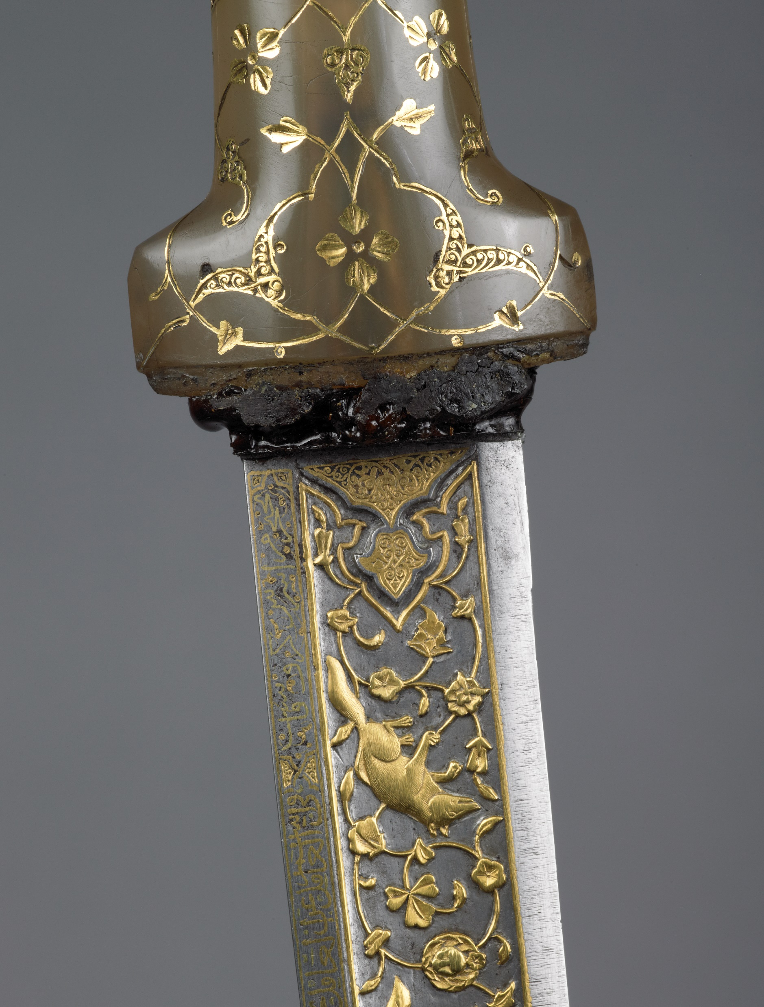
ISLAMIC PATTERNS
^{DAGGER - 15TH CENTURY}
AT THE WALLACE COLLECTION

Slide 15
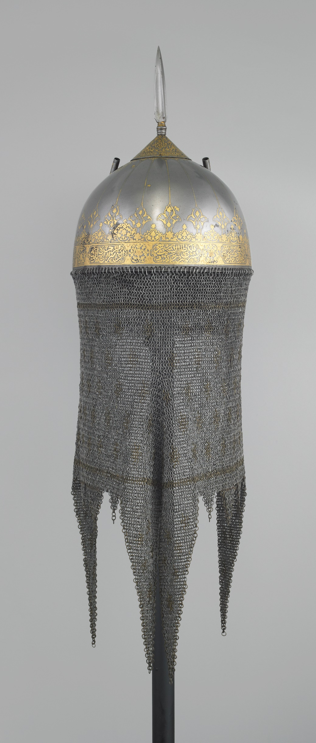
ISLAMIC PATTERNS
^{HELMET WITH LINING}
AT THE WALLACE COLLECTION
^{DATE}
^{MATERIALS}
^{PLACE}
^{MAKER}
^{Mid 17th century}
^{Gold, Steel}
^{Iran}
^{Unknown}

Slide 16
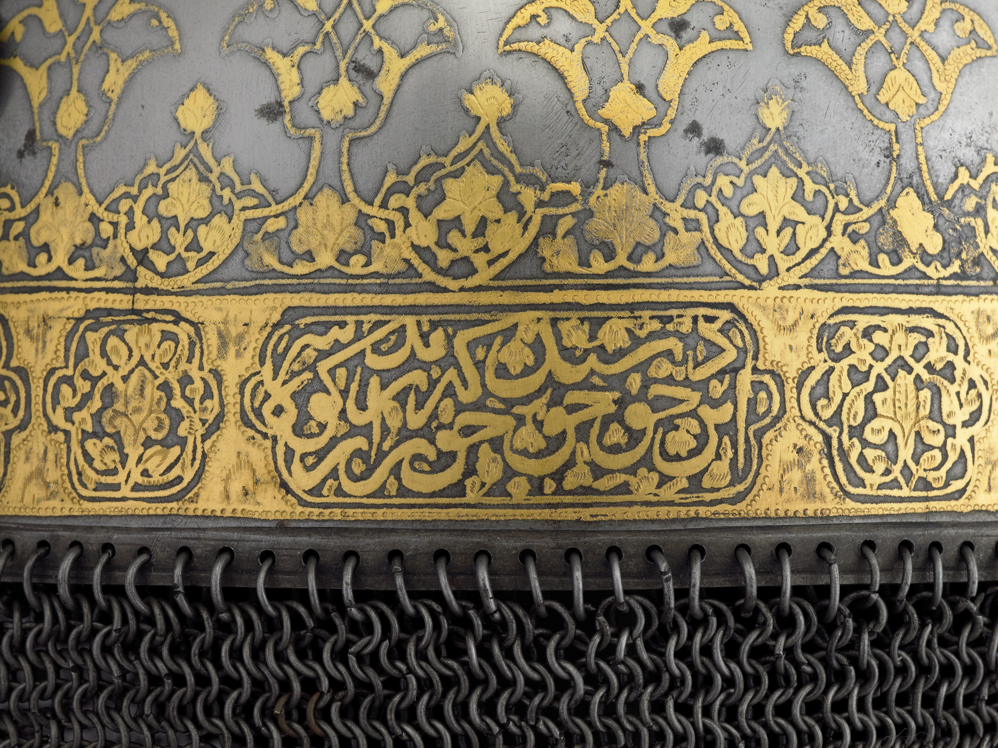
ISLAMIC PATTERNS
^{HELMET WITH LINING}
AT THE WALLACE COLLECTION

Slide 17
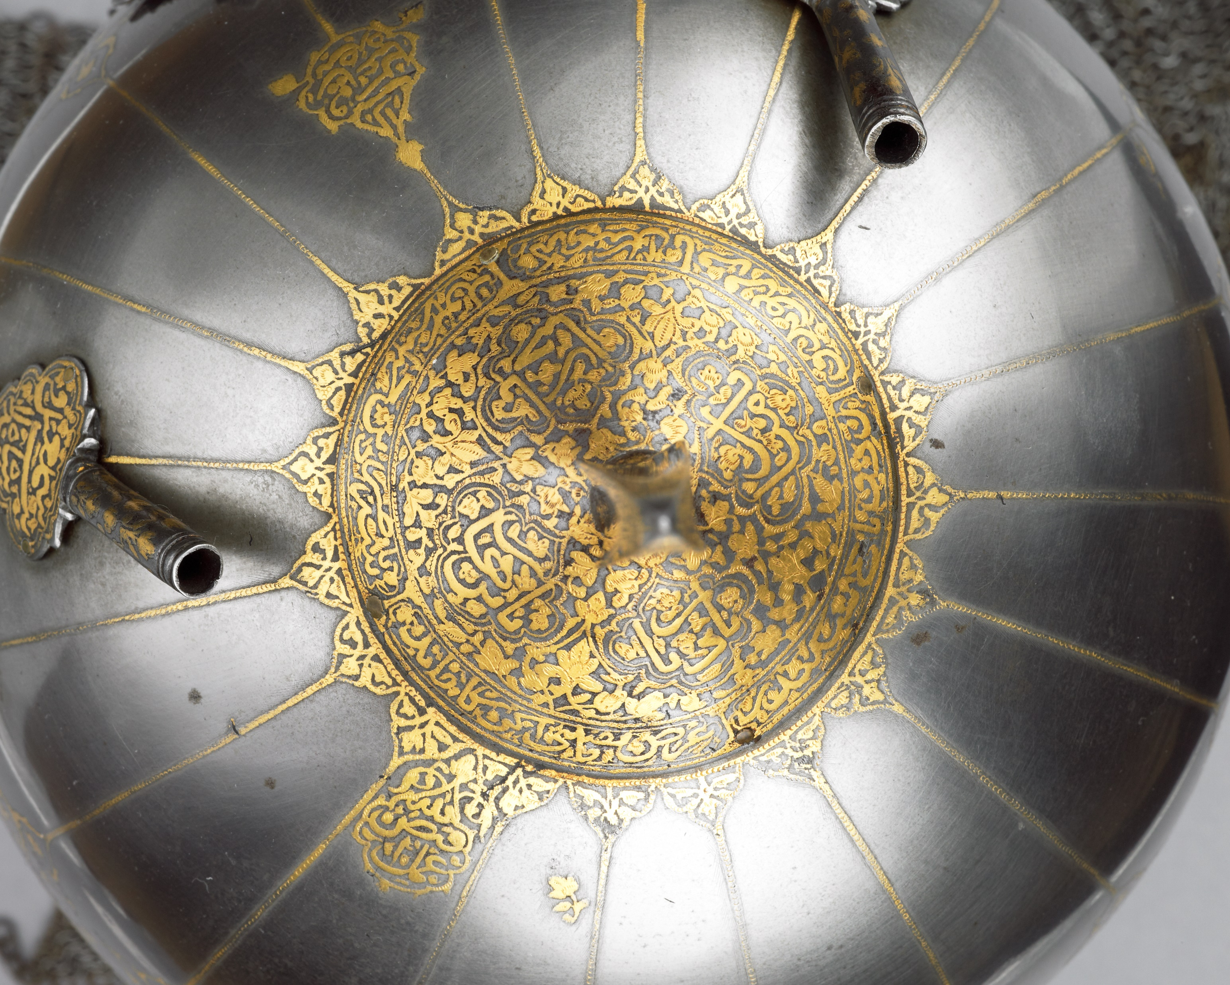
ISLAMIC PATTERNS
^{HELMET WITH LINING}
AT THE WALLACE COLLECTION

